Slide 1
Properties of estimators / Regression basics
Lecture 01 – Quantitative Data analysis 2

Slide 2
Motivation
A key purpose of statistical analysis is to understand the empirical relationships among variables.
In order to understand the relationships, we estimate parameters.
Thus, it is vital to know whether we are doing a good job with that estimation.
In other words, we want to know the properties of our estimators.

Slide 3
Three properties of estimators
Bias – We want estimators to be unbiased – or to have known biases.
Consistency – We want estimators to be consistent.
Efficiency – We want estimators to be efficient – or to be more efficient than other estimators.

Slide 4
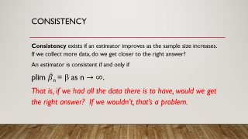
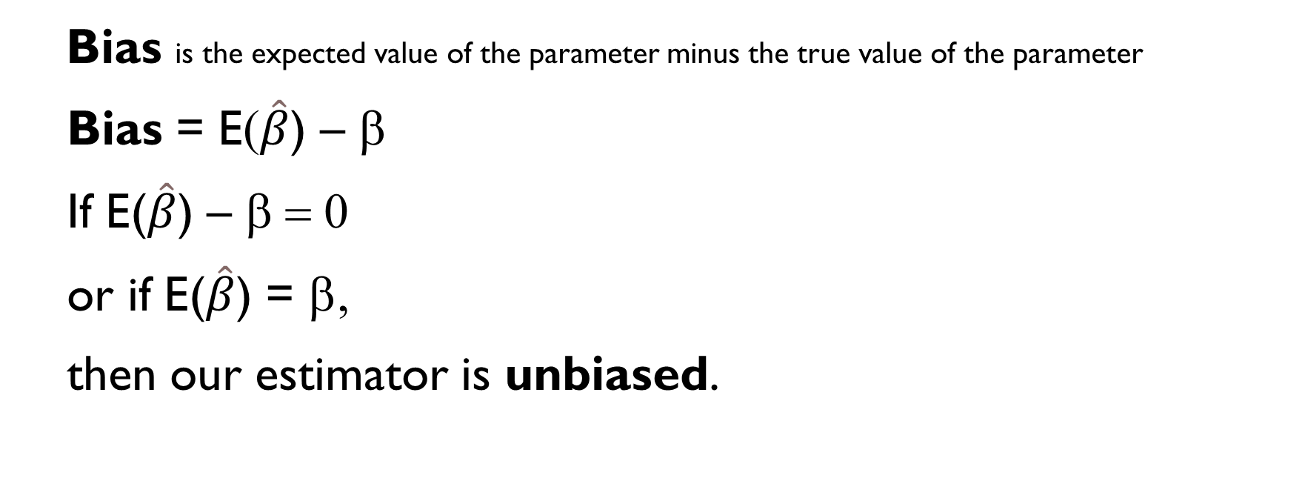
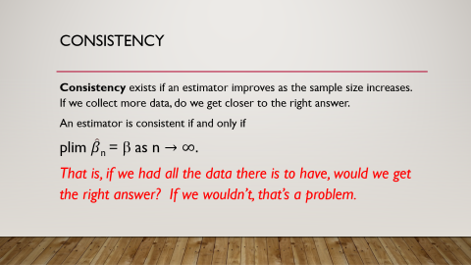
Bias
Bias is the expected value of the parameter minus the true value of the parameter
  Bias = E($\hat{β}$) – β
  If E($\hat{β}$) – β = 0
  or if E($\hat{β}$) = β,
  then our estimator is unbiased.
If our estimator is biased, but we know the direction and or magnitude of the bias, then we may be able to use that information to help us make inferences.

Slide 5
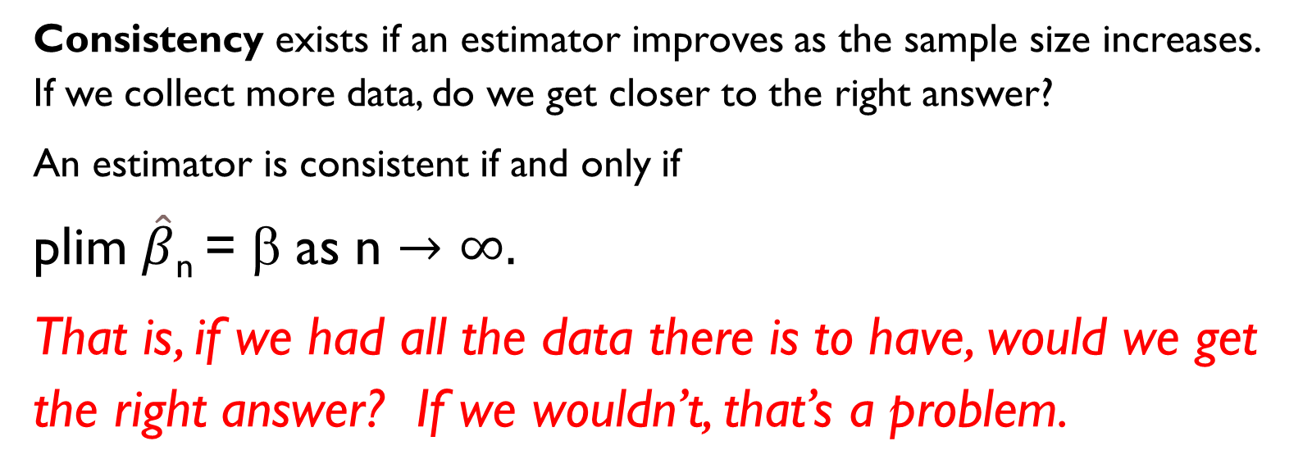
Consistency
Consistency exists if an estimator improves as the sample size increases. If we collect more data, do we get closer to the right answer?
An estimator is consistent if and only if
plim $\hat{β}$_{n} = β as n $→$ $∞.$
That is, if we had all the data there is to have, would we get the right answer? If we wouldn’t, that’s a problem.

Slide 6
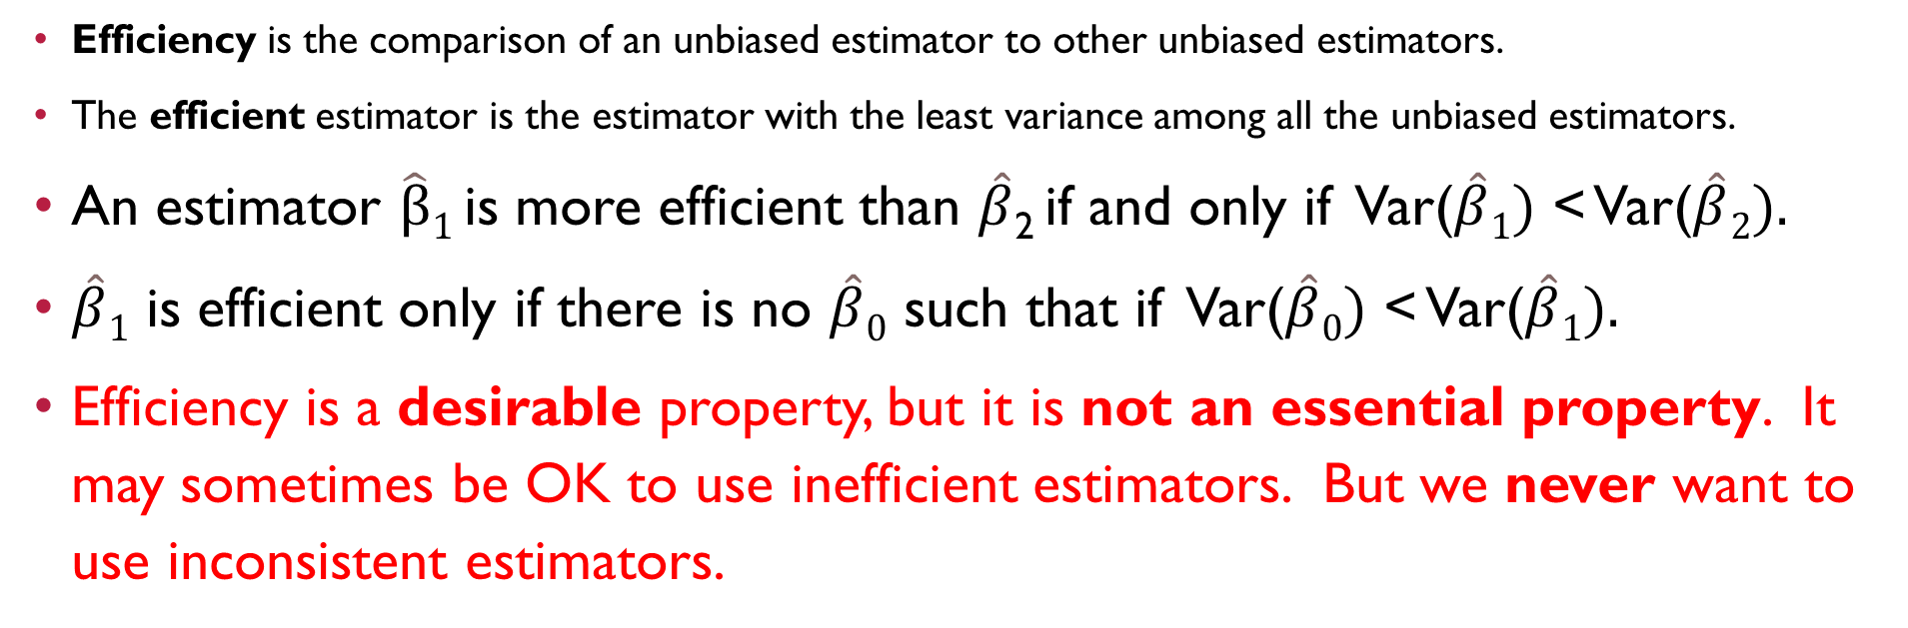
efficiency
Efficiency is the comparison of an unbiased estimator to other unbiased estimators.
The efficient estimator is the estimator with the least variance among all the unbiased estimators.
An estimator $\hat{β}1$ is more efficient than $\hat{β}$₂ if and only if Var($\hat{β}1)$ < Var($\hat{β}2).$
$\hat{β}1$ is efficient only if there is no $\hat{β}0$ such that if Var($\hat{β}0)$ < Var($\hat{β}1).$
Efficiency is a desirable property, but it is not an essential property. It may sometimes be OK to use inefficient estimators. But we never want to use inconsistent estimators.

Slide 7
Why we care about the properties of estimators
A given estimator may be unbiased, consistent, or efficient under some conditions but not under others.
For example, OLS regression is BLUE (the Best Linear Unbiased Estimator) when there is linearity, no multicollinearity, no endogeneity, and spherical errors.
BUT, OLS is inefficient when errors are heteroscedastic. (GLS is more efficient.)
Thus, we need to understand these properties in order to make informed choices among the many estimators we will consider in this course.

Slide 8
The basic Regression model
Y = β₀ + β₁ X₁ + β₂ X₂ + . . . + β_{k} X_{k} + ε
Where ε ~ N(0,1)

Slide 9

In Matrix notation
y = Xβ + ε
$\hat{β}$ = (X^{T}X)⁻¹X^{T}y

Slide 10
The Gauss-Markov Assumptions of linear regression
The model parameters are linear. (Linearity)
The observations have been selected randomly and are representative of the population. (Randomness)
The Xs are not perfectly collinear. (Nonmulticollinearity)
The Xs are fixed and contain no measurement error. That means they are not correlated with the errors of the regression. (Exogeneity)
All observations have the same expected variance and there is no intercorrelation between the errors of different observations. (Homoscedasticity)

Slide 11
There are many instances where the gauss-Markov assumptions are not satisfied
Model relationships are not linear.
The independent variables are measured with error.
The independent variables exert causal effects on one another.
Different observations have different expected variances.
The errors of the observations are intercorrelated.
The independent variables are highly intercorrelated.
Observations have been selected nonrandomly from the population.

Slide 12
Additionally, inefficiency may result when
The errors are not distributed N(0,1).
Examples: Binary dependent variable; Count dependent variable

Slide 13
Thus, this course seeks to understand new estimators that can address these situations
Open discussion

