Slide 1
Network Analysis Statistical Analysis of Social Network Data
Michael T. Heaney
University of Glasgow
June 15, 2023
Lecture 07

Slide 2
Presentations for Friday
Think of the task like making a conference presentation.
Prepare to speak for 15 minutes
We will allow 5 minutes of questions for each presentation. When your colleagues are speaking, THINK of at least ONE question to ask, so that we can have a discussion.

Slide 3
Presentations for Friday – Some Tips
Start by telling us briefly about the substantive problem or question that your data are meant to examine. Explain to your audience why what you are looking at is theoretically interesting.
Explain how your data are structured.
Next explain what you HOPED to do with your statistical analysis. How did your intended dependent and independent variable reflect the question that you sought to answer.
Explain the model that you were actually able to estimate. INTERPRET the results.

Slide 4
More Tips
Report your MCMC Diagnostics and Goodness of Fit plots. Show them to us and interpret them.
Tell us what you would like to do next if you had more time. What would be the next directions for your research?
Don’t worry if things didn’t work out as you hoped they would. The truth is that it takes more time to do this kind of work than you’ve had this week. Keep working on it!!!!

Slide 5
Models beyond ERGM

Slide 6
Models beyond ERGM
Temporal Exponential Random Graph Models (TERGM)

Slide 7
Models beyond ERGM
Temporal Exponential Random Graph Models (TERGM)
Stochastic Actor-Oriented Models (SAOM) – Siena

Slide 8
Models beyond ERGM
Temporal Exponential Random Graph Models (TERGM)
Stochastic Actor-Oriented Models (SAOM) – Siena
Generalized Exponential Random Graph Models (GERGM)

Slide 9
Models beyond ERGM
Temporal Exponential Random Graph Models (TERGM)
Stochastic Actor-Oriented Models (SAOM) – Siena
Generalized Exponential Random Graph Models (GERGM)
Relational Event Models (REMs)

Slide 10
Models beyond ERGM
Temporal Exponential Random Graph Models (TERGM)
Stochastic Actor-Oriented Models (SAOM) – Siena
Generalized Exponential Random Graph Models (GERGM)
Relational Event Models (REMs)
Latent Space Models

Slide 11
Models beyond ERGM
Temporal Exponential Random Graph Models (TERGM)
Stochastic Actor-Oriented Models (SAOM) – Siena
Generalized Exponential Random Graph Models (GERGM)
Relational Event Models (REMs)
Latent Space Models
Multilevel ERGMS (MLERGM)

Slide 12
Models beyond ERGM
Temporal Exponential Random Graph Models (TERGM)
Stochastic Actor-Oriented Models (SAOM) – Siena
Generalized Exponential Random Graph Models (GERGM)
Relational Event Models (REMs)
Latent Space Models
Multilevel ERGMS (MLERGM)
Ego ERGM

Slide 13
Models beyond ERGM
Temporal Exponential Random Graph Models (TERGM)
Stochastic Actor-Oriented Models (SAOM) – Siena
Generalized Exponential Random Graph Models (GERGM)
Relational Event Models (REMs)
Latent Space Models
Multilevel ERGMS (MLERGM)
Ego ERGM
And more to come – the field is rapidly evolving. You have to keep learning to keep up.

Slide 14
Temporal Exponential Random Graph Models

Slide 15
Temporal Exponential Random Graph Models
TERGM draws upon the same network generating process as does ERGM:

Slide 16
Re-write model using c()

Slide 17
Incorporate past time periods (N^{T})
The current time period is a function of what happened in past time periods.

Slide 18
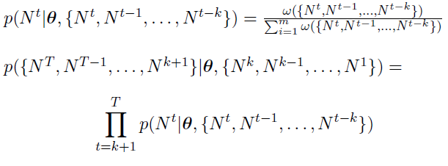
Now generalize to multiple time periods

Slide 19
h(N) can use same statistics as ERGM
Exogenous covariates
Single-period delayed reciprocity
Lagged Network / Positive Autoregression

Slide 20
Another h(N) statistic
Dyadic stability

Slide 21
Key Modeling Considerations
Is it reasonable to treat your network as changing in discrete time periods?
Does your data-generating process change over time? (Think of school friendship versus war.)

Slide 22
Key Data Considerations
Inter-temporal network statistics
Block-diagonal Adjacency Matrix

Slide 23
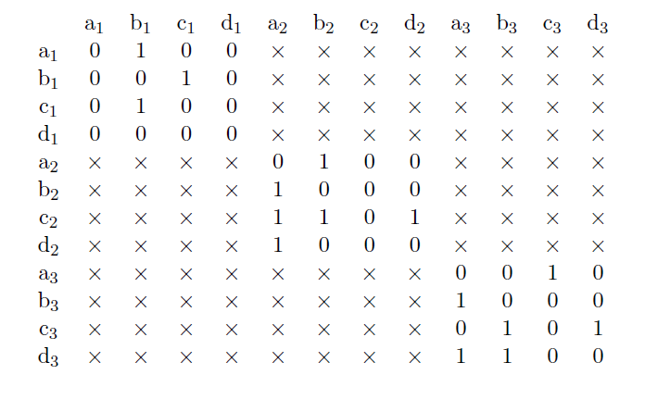
Block Diagonal Representation

Slide 24
Estimation
MCMC Pseudolikelihood for small networks
Bootstrap-corrected Maximum Pseudolikelidhood for large networks (BTERGM)

Slide 25
Comments/Questions?

Slide 26
Stochastic Actor-Oriented Model (SAOM)
Also known as “Siena”
Specification is only slightly different than TERGM
Models continuous time changes, rather than assuming discrete time
Big advantage: Models change in node attributes

Slide 27
Comments / Questions ?

