Slide 1
Network Analysis Statistical Analysis of Social Network Data
Michael T. Heaney
University of Glasgow
June 14, 2023
Lecture 06

Slide 2
Exponential Random Graph Models (ERGMs)

Slide 3
Exponential Random Graph Models (ERGMs)
This lecture draws heavily on:
Dean Lusher, Johan Koskinen, and Garry Robins. 2013. Exponential Random Graph Models for Social Networks: Theory, Methods, and Applications. New York: Cambridge University Press.
Skyler J. Cranmer, Bruce A. Desmarais, and Jason W. Morgan. 2021. Inferential Network Analysis. New York: Cambridge University Press.

Slide 4
Purpose
The goal of an ERGM is to predict the presence or absence of a network tie between every dyad in a network.

Slide 5
Purpose
The goal of an ERGM is to predict the presence or absence of a network tie between every dyad in a network.
By understanding the formation of dyads while explicitly accounting for network dependence, we understand the formation of network structures.

Slide 6
Purpose
The goal of an ERGM is to predict the presence or absence of a network tie between every dyad in a network.
By understanding the formation of dyads while explicitly accounting for network dependence, we understand the formation of network structures.
The presence of both exogenous and endogenous explanatory variables allows us to test competing explanations for network formation.

Slide 7
What kind of theory behind ERGMs?
There is not a single theory behind ERGMs in that they allow for the competitive test of multiple theories.

Slide 8
What kind of theory behind ERGMs?
There is not a single theory behind ERGMs in that they allow for the competitive test of multiple theories. (Just as there is no single theory behind regression.)

Slide 9
What kind of theory behind ERGMs?
There is not a single theory behind ERGMs in that they allow for the competitive test of multiple theories. (Just as there is no single theory behind regression.)
Yet there is a network meta theory – or framework – that underlies ERGMs.

Slide 10
What kind of theory behind ERGMs?
There is not a single theory behind ERGMs in that they allow for the competitive test of multiple theories. (Just as there is no single theory behind regression.)
Yet there is a network meta theory – or framework – that underlies ERGMs. (Just as there is a meta theory behind regression which relates to independent social action.)

Slide 11
The Meta Theory behind ERGMs
Social networks are locally emergent (e.g., preferential attachment)

Slide 12
The Meta Theory behind ERGMs
Social networks are locally emergent (e.g., preferential attachment)
Tie formation depends both on the formation of other ties (i.e., network dependence) and on attributes of actors, ties, and other exogenous factors.

Slide 13
The Meta Theory behind ERGMs
Social networks are locally emergent (e.g., preferential attachment)
Tie formation depends both on the formation of other ties (i.e., network dependence) and on attributes of actors, ties, and other exogenous factors.
Patterns in networks are part of ongoing social processes.

Slide 14
The Meta Theory behind ERGMs
Social networks are locally emergent (e.g., preferential attachment)
Tie formation depends both on the formation of other ties (i.e., network dependence) and on attributes of actors, ties, and other exogenous factors.
Patterns in networks are part of ongoing social processes.
Multiple processes can operate simultaneously (e.g., homophily and triadic closure).

Slide 15
The Meta Theory behind ERGMs
Social networks are locally emergent (e.g., preferential attachment)
Tie formation depends both on the formation of other ties (i.e., network dependence) and on attributes of actors, ties, and other exogenous factors.
Patterns in networks are part of ongoing social processes.
Multiple processes can operate simultaneously (e.g., homophily and triadic closure).
Networks are both structured and stochastic.

Slide 16
Network Configurations
A network configuration is a possible subgraph that may represent a local regularity in a social network structure.

Slide 17
Some Common Network Configurations
Reciprocity
Transitive closure
Activity /
Out two-star
Popularity /
in two-star
Homophily
Heterophily
Two-path
Arc / Density

Slide 18
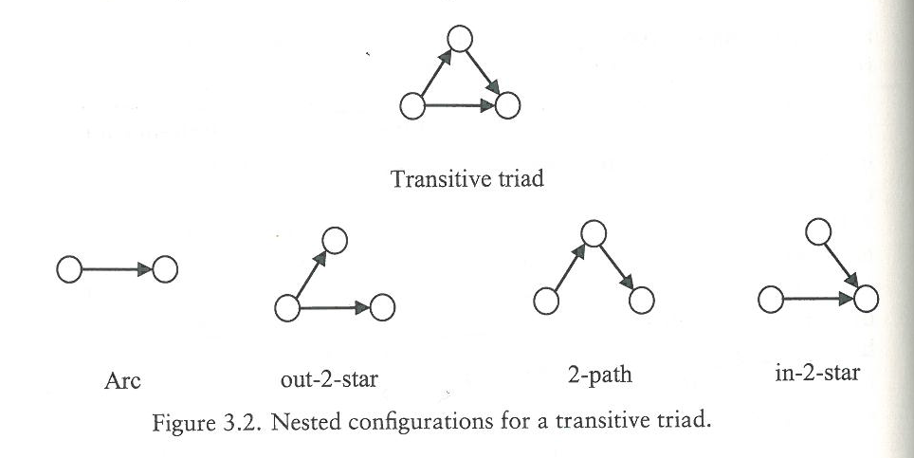
Triadic Structures

Slide 19
Some Configurations in Multiplex Networks
Co-occurrence
Entrainment
Reciprocity
A
B
A
B
A
B

Slide 20
Some Configurations in Two-Mode Networks
2 B1 Stars
2 B2 Stars
Four Cycle
2
1
2
1
2
1
2
1
1
2

Slide 21
Types of Network Dependence

Slide 22
Types of Network Dependence
Bernoulli Independence (ties are independent)

Slide 23
Types of Network Dependence
Bernoulli Independence (ties are independent)
Dyadic Dependence (e.g., reciprocity)

Slide 24
Types of Network Dependence
Bernoulli Independence (ties are independent)
Dyadic Dependence (e.g., reciprocity)
Markov Dependence – Nodes are dependent if they share a tie.

Slide 25
Types of Network Dependence
Bernoulli Independence (ties are independent)
Dyadic Dependence (e.g., reciprocity)
Markov Dependence – Nodes are dependent if they share a tie.
Social Circuit Dependence (e.g., 4-cycles)

Slide 26
Types of Network Dependence
Bernoulli Independence (ties are independent)
Dyadic Dependence (e.g., reciprocity)
Markov Dependence – Nodes are dependent if they share a tie.
Social Circuit Dependence (e.g., 4-cycles)
Higher-order dependence (e.g., geometrically weighted dependence)

Slide 27
Overview of Specification Process

Slide 28
The Problem of Network Statistics

Slide 29
The Problem of Network Statistics
We observe one instantiation of a network, but there are many possible instantiation of a network.

Slide 30
The Problem of Network Statistics
We observe one instantiation of a network, but there are many possible instantiation of a network.
In a directed graph, there are 2^{n(n-1)} possible instantiations of the network, which is a VERY large number.

Slide 31
The Problem of Network Statistics
We observe one instantiation of a network, but there are many possible instantiation of a network.
In a directed graph, there are 2^{n(n-1)} possible instantiations of the network, which is a VERY large number.
Since it is generally beyond our computing capacity to consider all possible graphs, we take a sample random graphs (our “sample space”), which provides a baseline distribution for our analysis.

Slide 32
The Statistical Task of an ERGM
ERGM tries to find a distribution of random graphs that, on average, have similar properties to our observed network in terms of nodes, links, reciprocity, transitivity, etc.

Slide 33
The Statistical Task of an ERGM
ERGM tries to find a distribution of random graphs that, on average, have similar properties to our observed network in terms of nodes, links, reciprocity, transitivity, etc.
ERGM tries to find estimates such that simulations from the network are not extremely different from our observed network.

Slide 34

Logistic Regression
$$\operatorname{Pr}\left(Xij=1 \right|θ)$$
= $\frac{exp\{θ1 Xij,1+θ2 Xij,1+. . .+θk Xij,k\}}{\sum{1+ }exp⁡\{θ1 Xij,1+θ2 Xij,1+. . .+θk Xij,k\}}$
log$\frac{\operatorname{Pr}\left(Xij=1 \right|θ) }{\operatorname{Pr}\left(Xij=0 \right|θ) }$
=$θ0+θ1wij,1+ θ2wij,2+ …+θkwij,k$

Slide 35
Departures from Logistic Regression

Slide 36
Departures from Logistic Regression
We usually want to add endogenous covariates in addition to exogenous covariates. In fact, we do not have an ERGM unless we have endogenous covariates.

Slide 37
Departures from Logistic Regression
We usually want to add endogenous covariates in addition to exogenous covariates. In fact, we do not have an ERGM unless we have endogenous covariates.
Each tie is conditional on the rest of the graph.

Slide 38
Departures from Logistic Regression
We usually want to add endogenous covariates in addition to exogenous covariates. In fact, we do not have an ERGM unless we have endogenous covariates.
Each tie is conditional on the rest of the graph.
Change statistics incorporate the effect of any individual tie switching from 0 to 1 or vice versa.

Slide 39
Departures from Logistic Regression
We usually want to add endogenous covariates in addition to exogenous covariates. In fact, we do not have an ERGM unless we have endogenous covariates.
Each tie is conditional on the rest of the graph.
Change statistics incorporate the effect of any individual tie switching from 0 to 1 or vice versa.
There is no single ERGM – there is a different ERGM for each dependence assumption.

Slide 40
Departures from Logistic Regression
We usually want to add endogenous covariates in addition to exogenous covariates. In fact, we do not have an ERGM unless we have endogenous covariates.
Each tie is conditional on the rest of the graph.
Change statistics incorporate the effect of any individual tie switching from 0 to 1 or vice versa.
There is no single ERGM – there is a different ERGM for each dependence assumption.
The technically correct terminology is “exponential- family random graph model” – but “family” is traditionally dropped.

Slide 41
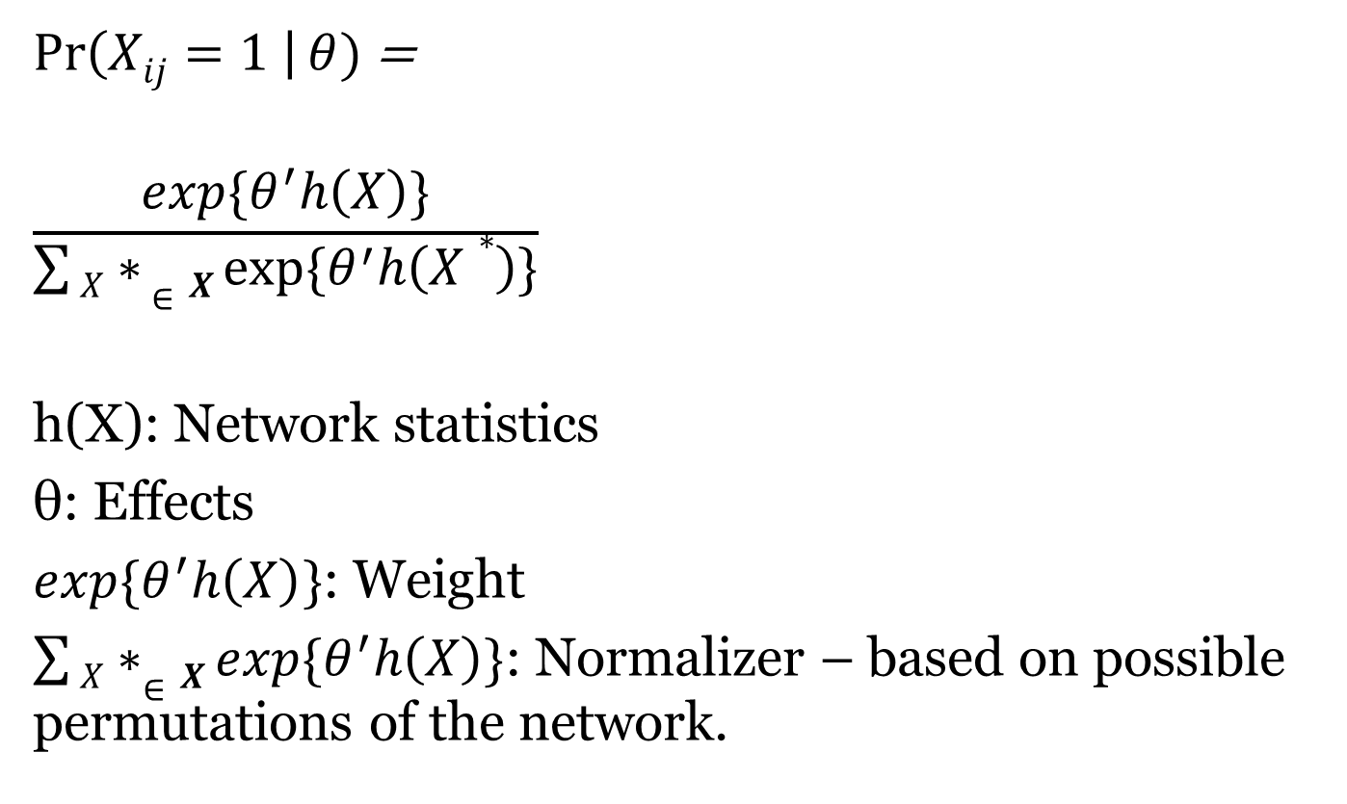
Exponential-Family Random Graph Models
$\operatorname{Pr}\left(Xij=1 \right|θ)$ =
$$\frac{exp\{θ^{′}h\left(X\right)\}}{\sum{X∗ ∈X}exp⁡\{θ^{′}h\left(X∗\right)\}}$$
h(X): Network statistics
θ: Effects
$exp\{θ^{′}h\left(X\right)\}$: Weight
$\sum{X∗∈X}exp\{θ^{′}h\left(X\right)\}$: Normalizer – based on possible permutations of the network.

Slide 42
Specifying h(X)
Reciprocity
Transitivity
Geometrically weighted or “curved” models.
h(X) may consist of these and / or other configurations.

Slide 43
One-Mode versus Two-Mode ERGMs
ERGMs can be estimated on either one-model or two-mode networks.
Two adjustments are needed to fit a two-mode network.
In a two-model network, the X needs to be restricted to possible values only – i.e., structural zeros.
Two-mode networks have a different h(X) structure, such using B1 Star and B2 Star variables.

Slide 44
Count ERGMs
Binary ERGMs can readily be extended to address variation in the strength of ties by using count ERGMs.
A common approach to use a Poisson distribution as the reference distribution.
For details, see the work of Pavel Krivitsky, such as https://cran.r-project.org/web/packages/ergm.count/ergm.count.pdf
Generalized Exponential Random Graph Models (GERGMs) can also tackle counts but they further accommodate continuous variables and, thus, represent a more substantial departure from the binary ERGM framework.

Slide 45
Estimating ERGMs

Slide 46
Estimating ERGMs
There are different methods of estimating ERGMs.

Slide 47
Estimating ERGMs
There are different methods of estimating ERGMs.
Markov Chain Monte Carlo (MCMC) estimation is the most common method.

Slide 48
Estimating ERGMs
There are different methods of estimating ERGMs.
Markov Chain Monte Carlo (MCMC) estimation is the most common method.
MCMC is an approximation of Maximum Likelihood Estimation, which is generally infeasible in large networks. Approximates MLE in large samples.

Slide 49
Estimating ERGMs
There are different methods of estimating ERGMs.
Markov Chain Monte Carlo (MCMC) estimation is the most common method.
MCMC is an approximation of Maximum Likelihood Estimation, which is generally infeasible in large networks. Approximates MLE in large samples.
Proceeds by making one change to a network (substituting a 0 for a 1, vice versa) repeated many times to generate a vector of change statistics (h(X)), which is used to estimate the ERGM.

Slide 50
Estimating ERGMs
There are different methods of estimating ERGMs.
Markov Chain Monte Carlo (MCMC) estimation is the most common method.
MCMC is an approximation of Maximum Likelihood Estimation, which is generally infeasible in large networks. Approximates MLE in large samples.
Proceeds by making one change to a network (substituting a 0 for a 1, vice versa) repeated many times to generate a vector of change statistics (h(X)), which is used to estimate the ERGM.
Degeneracy is a common problem because of the large number of possible permutations of the network – leads to large jumps in the network’s density.

Slide 51
Calibrating Estimation

Slide 52
Calibrating Estimation
We can increase the precision of ERGMs by increasing the number of MCMC samples that we take. The default is 10,000 in Statnet. But it is not unreasonable to use 1,000,000 for a final model.

Slide 53
Calibrating Estimation
We can increase the precision of ERGMs by increasing the number of MCMC samples that we take. The default is 10,000 in Statnet. But it is not unreasonable to use 1,000,000 for a final model.
Burnin is the number of initial chains that are discarded at the beginning of an estimation process. This is the length of the learning period for the ERGM. Increasing burnin increases precision.

Slide 54
Calibrating Estimation
We can increase the precision of ERGMs by increasing the number of MCMC samples that we take. The default is 10,000 in Statnet. But it is not unreasonable to use 1,000,000 for a final model.
Burnin is the number of initial chains that are discarded at the beginning of an estimation process. This is the length of the learning period for the ERGM. Increasing burnin increases precision.
Higher MCMC samples and burnin are good for the precision of your model, but lengthen computational time. Work with low numbers (≈10,000) in developing a model, then run a higher number for the final model.

Slide 55
Calibrating Estimation
We can increase the precision of ERGMs by increasing the number of MCMC samples that we take. The default is 10,000 in Statnet. But it is not unreasonable to use 1,000,000 for a final model.
Burnin is the number of initial chains that are discarded at the beginning of an estimation process. This is the length of the learning period for the ERGM. Increasing burnin increases precision.
Higher MCMC samples and burnin are good for the precision of your model but lengthen computational time. Work with low numbers (≈10,000) in developing a model, then run a higher number for the final model.
We can use the Geweke statistic to test if the MCMC process is working. There a significant difference between staring and ending values if p $≤$ 0.50 (not a mistake).

Slide 56
Interpreting ERGMs

Slide 57
Interpreting ERGMs
Terms are included in ERGMs based on beliefs about particular dependency structures.

Slide 58
Interpreting ERGMs
Terms are included in ERGMs based on beliefs about particular dependency structures.
Terms cannot be interpreted separately from one another because they are nested within one another.

Slide 59
Interpreting ERGMs
Terms are included in ERGMs based on beliefs about particular dependency structures.
Terms cannot be interpreted separately from one another because they are nested within one another.
Still, the general interpretation of ERGM coefficients resembles a logit model.

Slide 60
Interpreting ERGMs
Terms are included in ERGMs based on beliefs about particular dependency structures.
Terms cannot be interpreted separately from one another because they are nested within one another.
Still, the general interpretation of ERGM coefficients resembles a logit model.
ERGMs are intended to be a simplification of a stochastic network generating process that exists in reality.

Slide 61
Assessing ERGMs

Slide 62
Assessing ERGMs
We want to make sure that our ERGM estimates converge. That is, additional sampling does not appreciably change our estimates.

Slide 63
Assessing ERGMs
We want to make sure that our ERGM estimates converge. That is, additional sampling does not appreciably change our estimates.
We want to make sure that our ERGM has a good fit to our data. That is, simulations based on our ERGM generates networks that are similar in structure to our observed network.

Slide 64
Assessing ERGMs
We want to make sure that our ERGM estimates converge. That is, additional sampling does not appreciably change our estimates.
We want to make sure that our ERGM has a good fit to our data. That is, simulations based on our ERGM generates networks that are similar in structure to our observed network.
Be carful not to overfit the data based on goodness-of-fit assessments.

Slide 65
Assessing ERGMs
We want to make sure that our ERGM estimates converge. That is, additional sampling does not appreciably change our estimates.
We want to make sure that our ERGM has a good fit to our data. That is, simulations based on our ERGM generates networks that are similar in structure to our observed network.
Be carful not to overfit the data based on goodness-of-fit assessments.
We will talk more about assessing ERGMs during the computer exercise component of the day.

Slide 66
Comments / Questions?

