Slide 1
Network Analysis Statistical Analysis of Social Network Data
Michael T. Heaney
University of GlasgoW
June 13, 2023
Lecture 04

Slide 2
Network Descriptive Statistics

Slide 3
Application of Descriptive Statistics
Descriptive statistics combined with graphical analysis are often sufficient network analysis for many research purposes.
A good software package for working with network descriptive statistics and graphs is UCINet.
https://sites.google.com/site/ucinetsoftware/home

Slide 4
Density
Density is a property of a network.
Density is the general level of linkage in the network
Density = # of lines / # of lines in a complete graph
Density = # of lines / [ (n (n-1))/2 ]
Note that n=number of nodes

Slide 5
Example of Density Calculations
Suppose a graph has 4 lines and 4 nodes
Density = 4 / [ (4 ( 4-1))/2]
= 4 / 6
= 0.66667
This graph has two-thirds of all possible links.

Slide 6
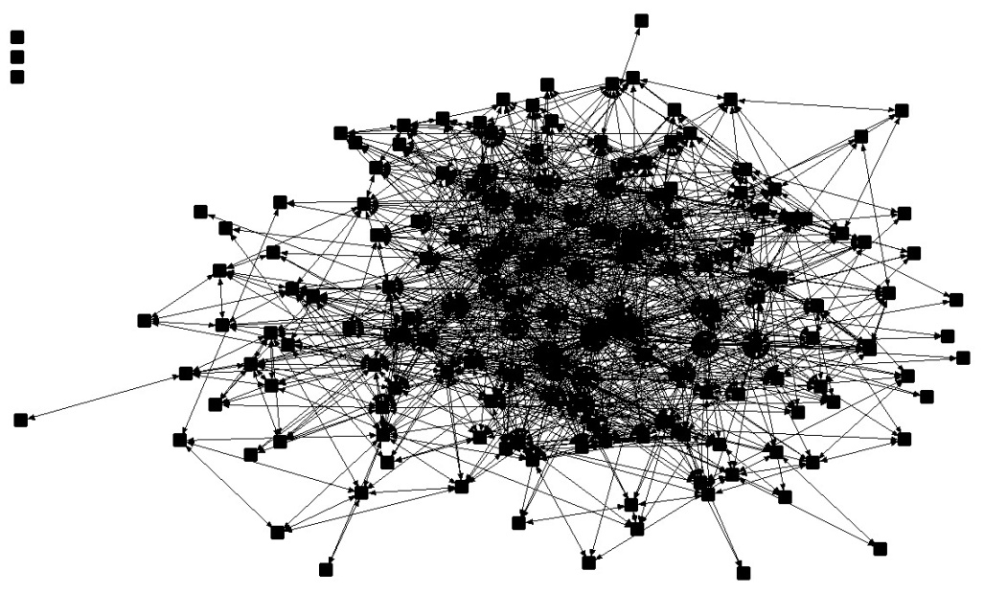
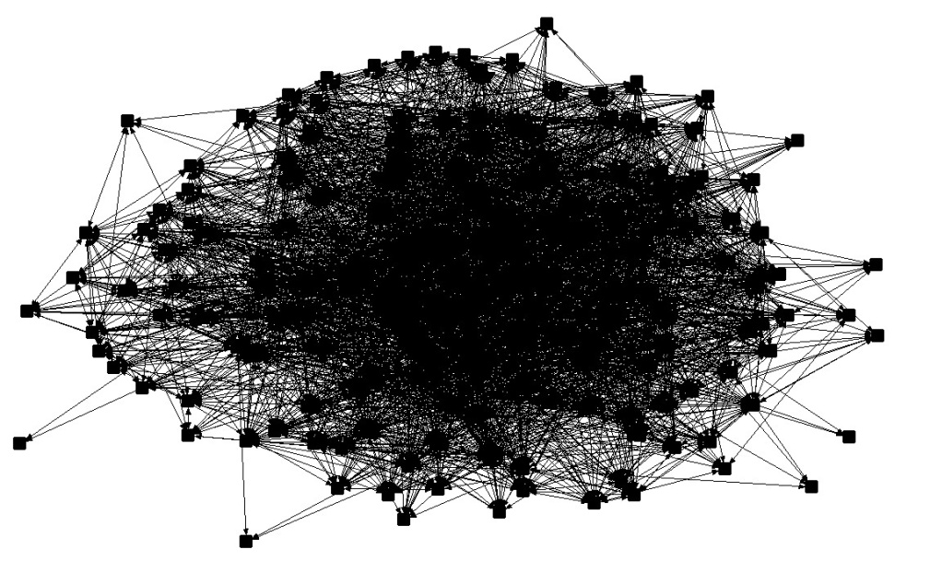
Low Density vs. High Density
Relatively Low Density
Relatively High Density
James Fowler et al., “Causality in Political Networks,” American Politics Research (March 2011).

Slide 7
Low Density vs. High Density
Relatively Low Density
Relatively High Density
Density = 0.098
Density = 0.268
James Fowler et al., “Causality in Political Networks,” American Politics Research (March 2011).

Slide 8
Reciprocity
If A cites B, then B cites A. If B cites A, then A cites B.
It is a measure of mutuality in a network.
Peer networks tend to have high reciprocity, while hierarchical networks tend to have low reciprocity.

Slide 9
Asymmetry
If A cites B, then B fails to cite A. If B cites A, then A fails to cite B.
It is the opposite of reciprocity.
Status-oriented networks tend to have high asymmetry.

Slide 10
Triads
A triad is any set of three nodes.
Four possible structures in an undirected graph.
Sixteen possible unique structures in a directed graph.
Triads have a special place in network theory because some of the earliest network analysis (Georg Simmel, “The Triad”)

Slide 11
Transitivity
Transitivity is a property of triads.
A triad is transitive if i→j and j→k implies i→k
If Greta & Carlos are friends and Carlos & Jana are friends, then Greta & Jana are friends.
The percentage of transitive triads in a network is a property of interest.

Slide 12
Symmetry
If the upper triangle of a network is identical to the lower triangle, then the network is symmetric.
Any undirected network is symmetric.
A directed network may be symmetric, but it is not necessarily so.
If a network is not symmetric, it is possible to force it to be so.

Slide 13
Dyad and Triad Census
Graph-level measures

Slide 14
Cliques
A clique is a subgraph in which all the nodes in a set are linked to one another.

Slide 15
Can we find the cliques?
B
A
C
E
F
D
G
H

Slide 16
Can we find the cliques?
ABCD
ABC
ADC
BCD
EFG
EGH
AB
AC
AD
BC
BD
CD
EF
EG
EH
FG
FH
GH
B
A
C
E
F
D
G
H

Slide 17
Cliques by Size
When we are looking for cliques, we might choose to search only for cliques of a certain size.
For example, we might be interested only in cliques of size 4 or greater.
Dyads and isolates are cliques, but only trivially so.

Slide 18
Degree
Degree is a property of a node.
The degree of a node is equal to the number of links that it has.
Example: Person’s “degree” is the number of contacts that she or he has in a social network.
A has a degree of 5.
What is the degree of F?
B
F
C
A
E
D

Slide 19
Degree Distribution
A degree distribution a property of a network.
A degree distribution is the number of nodes of a network that have each degree level.
A degree distribution may be a good way of summarizing the activity of nodes in a network.
May be a good way of comparing networks to one another.

Slide 20
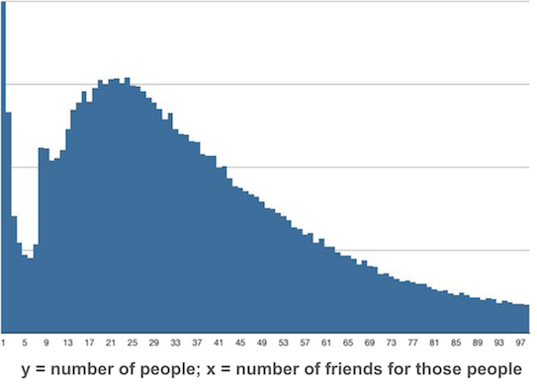
Example: Degree Distribution of Facebook Friends
http://www.deviantbits.com/blog/social-graphs-vs-interest-graphs.html

Slide 21
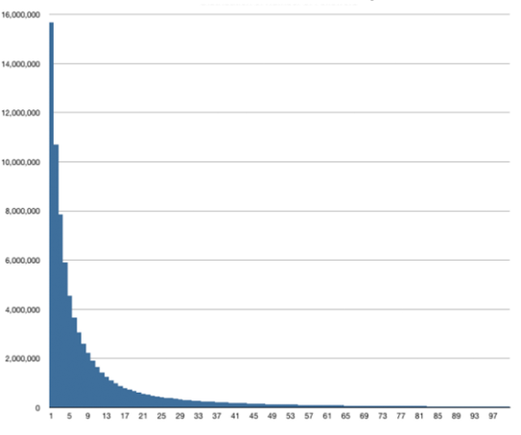
Example: Degree Distribution of Twitter Followers
http://www.deviantbits.com/blog/social-graphs-vs-interest-graphs.html

Slide 22
Indegree and Outdegree
Directed networks only
Indegree – The number of links that a node receives in a directed network (e.g., the number of people who say that I am their friend).
Outdegree – The number of links that a node sends in a directed network (e.g., the number of people who I cite as friends).
Comparing the indegree distribution and the outdegree distribution may be a good way to summarize a network, especially if there is a difference between the two. Giving a citation and receiving a citation mean very different things.

Slide 23
Indegree vs. Outdegree for Influence Cites

Slide 24
Calculating Degree
What is A’s degree What is B’s indegree,
outdegree?
A
B

Slide 25
Path
Path – route from one node to another
ABEDHG is a path from a A to G
Note that there are multiple paths from A to G.
F
G
I
A
E
B
H
C
D

Slide 26
Path Length
Path length is the number of steps in a path.
The path length of ABEDHG is 5.
F
G
I
A
E
B
H
C
D

Slide 27
Geodesic
Geodesic – the shortest path from one node to another
ABEG is the geodesic from A to G
F
G
I
A
E
B
H
C
D

Slide 28
Distance
Distance – the length of the shortest path from one node to another
This distance from A to G is 3 steps.
F
G
I
A
E
B
H
C
D

Slide 29
Geodesic vs. Distance
“Geodesic” and “Distance” are highly similar concepts, but don’t confuse them!
A geodesic is a path – e.g., DEFG.
A distance is a number – e.g., 3

Slide 30
Centrality vs. Centralization

Slide 31
What is Centrality?
It is a property of a node in a graph – that is, the property of an individual or unit under study.
It is a measure of the prominence of that one point relative to other points.
There are different conceptions of what it means to be “central”.

Slide 32
What is Centralization?
It is a property of the graph as a whole.
Refers to the overall cohesion or integration of the graph.
Compares most central point to all other points. Ratio of the actual sum of differences to the maximum possible sum of differences.
Network A
Network B
Network C

Slide 33
Why are Centrality and Centralization Important?
Access to information and ideas
Interaction among members of the network
Control the flow of information, resources, and other network content
Visibility
Ability to act together collectively

Slide 34
Multiple Ways to Calculate Centrality
Degree
Closeness
Betweenness
Eigenvector

Slide 35
Calculating Centrality
Degree – Proportional to the number of other nodes to which a node is linked – Number of links divided by (n-1).

Slide 36
Calculating Centrality
Degree – Proportional to the number of other nodes to which a node is linked – Number of links divided by (n-1).
Closeness – The sum of geodesic distances (shortest paths) to all other points in the graph. Divide by (n-1), then invert.

Slide 37
Calculating Centrality
Degree – Proportional to the number of other nodes to which a node is linked – Number of links divided by (n-1).
Closeness – The sum of geodesic distances (shortest paths) to all other points in the graph. Divide by (n-1), then invert.
Betweenness – The extent to which a particular point lies ‘between’ other points in the graph; how many shortest paths (geodesics) is it on? A measure of brokerage or gatekeeping.

Slide 38
Betweenness Centrality
Betweenness Centrality of Node i =
$$\sum_{j<k}{gjk(ni)/}gjk$$
where i is a node that is distinct from j and k,
and where g_{jk}(n_{i}) is the number of geodesics linking the two actors that contain actor _{i}.
This measure can be standardized to the [0,1] interval by dividing by the number of dyads in the network minus n_{i}:
(n-1)(n-2)/2
From Stanely Wassertman and Katherine Faust, Social Network Analysis (Cambridge University Press, 1994), p. 190.

Slide 39
Calculating Centrality
Degree – Proportional to the number of other nodes to which a node is linked – Number of links divided by (n-1).
Closeness – The sum of geodesic distances (shortest paths) to all other points in the graph. Divide by (n-1), then invert.
Betweenness – The extent to which a particular point lies ‘between’ other points in the graph; how many shortest paths (geodesics) is it on? A measure of brokerage or gatekeeping.
Eigenvector– A weighted measure of centrality that takes into account the centrality of other nodes to which a node is connected. That is, being connect with other central nodes increases centrality. E.g., secretary of powerful person. Google’s page rank algorithm is a variant of Eigenvector Centrality.

Slide 40
Eigenvector Centrality
Eigenvector Centrality of Node i =
$\frac{1}{λ}\sum_{j<k}{Networkn}$n_{i}
where i is a node that is distinct from j and k,
Network_{n} is an adjacency matrix with n nodes,
n_{i} is the realized value of a link in the network,
And λ is an eigenvector solved through an iterative algorithm.

Slide 41
Other Centrality Measures
There are a large number of other possible measures of centrality.
For example, there are various ways to measure centrality in directed networks.
K-step reach, average recipient distance, etc., etc.
Different measures are often highly correlated

Slide 42
Calculating Centralization
Step 1. Compute centrality of all points.
Step 2. Identify the most central point.
Step 3. Compute the difference between the centrality of the most central point and all other points. Sum those differences.
Step 4. Repeat steps 1 through 3 for the most centralized possible network with that same number of nodes. Note that a 'star' network is always the most centralized network.
Step 5. Divide your answer in Step 3 by your answer in Step 4.

Slide 43
Calculating Centralization
Step 1. Compute the Centrality of All Points
Degree Centrality of Node A = ?
Degree Centrality of All Node Bs = ?
Degree Centrality of All Node Cs = ?
C
B
A

Slide 44
Calculating Centralization
Step 1. Compute the Centrality of All Points
Degree Centrality of Node A = 4 / (9-1) = 4 / 8 = 0.50
Degree Centrality of All Node Bs = 2 / (9-1) = 2 / 8 = 0.25
Degree Centrality of All Node Cs = 1 / (9-1) = 1 / 8 = 0.125
C
B
A

Slide 45
Calculating Centralization
Step 2. Identify the Most Central Point
Degree Centrality of Node A = 4 / (9-1) = 4 / 8 = 0.50
Degree Centrality of Node B = 2 / (9-1) = 2 / 8 = 0.25
Degree Centrality of Node C = 1 / (9-1) = 1 / 8 = 0.125
Node A is the most central point because centrality = 0.50
C
B
A

Slide 46
Calculating Centralization
Step 3. Compute the difference between the centrality of the most central point and all other points. Sum those differences.
Sum of Differences: (4x(0.50-0.25))+(4x(0.50-0.125))=2.5

Slide 47
Calculating Centralization
Step 4. Repeat steps 1 through 3 for the most centralized possible network with that same number of nodes. Note that a 'star' network is always the most centralized network.
Degree Centrality of Node A = 8 / (9-1) = 8 / 8 = 1.00
Degree Centrality of All Node Bs = 1 / (9-1) = 1 / 8 = 0.125
Sum of Differences: (8x(1.00-0.125))=7
B
A

Slide 48
Calculating Centralization
Step 5. Divide your answer in Step 3 by your answer in Step 4.
Centralization = Actual Sum of Differences
Maximum Possible Sum of Differences
Centralization = 2.5 / 7
Centralization = 0.357

Slide 49
Calculating Centralization
Step 5. Divide your answer in Step 3 by your answer in Step 4.
Centralization = Actual Sum of Differences
Maximum Possible Sum of Differences
Centralization = 2.5 / 7
Centralization = 0.357
Note that we used degree centrality for this computation, but we could have used any centrality measure, such as betweenness or Eigenvector centrality.

Slide 50
Questions / Comments ?

