Slide 1
Network Analysis Statistical Analysis of Social Network Data
Michael T. Heaney
University of GlasgoW
June 12, 2023
Lecture 03

Slide 2
Research Design and Data

Slide 3
Research Design and Data
Whole Networks vs. Ego Networks
Boundary Specification
Questionnaire Design
Data Formats

Slide 4
Whole Networks vs. Ego Networks

Slide 5
Whole Networks vs. Ego Networks
Whole networks – observer has information about all nodes and links in the network – all network-level statistics can be computed

Slide 6
Whole Networks vs. Ego Networks
Whole networks – observer has information about all nodes and links in the network – all network-level statistics can be computed
Ego Networks – observer only has information about the links to a sample of the nodes – network-level statistics cannot be computed – e.g., we know about the properties of the first-degree contacts, such as sex, age, etc.

Slide 7
Whole Networks vs. Ego Networks
Whole networks – observer has information about all nodes and links in the network – all network-level statistics can be computed
Ego Networks – observer only has information about the links to a sample of the nodes – network-level statistics cannot be computed – e.g., we know about the properties of the first-degree contacts, such as sex, age, etc.
It is not the networks themselves that differ, but our ability to collect information about them.

Slide 8
Whole Networks vs. Ego Networks
Whole networks – most common in the study of elites and institutions, as well as computer networks.
Ego Networks – most common in the study of individual behavior

Slide 9
Whole Networks vs. Ego Networks
Whole networks – all network analysis techniques can be used
Ego Networks – analysis techniques involve analysis of the alters of focal persons

Slide 10
Snowball Sampling
Snowball sampling creates an intermediate network that is somewhere between an ego network and a whole network.
Procedure:
1. Select a random sample from the population
2. Ask each respondent in the random sample about network alters.
3. Contact those alters and request information on those alters.
4. Contact the alters of the alters.
5. Continue….

Slide 11
Problems with Snowball Sampling
Snowball sampling selects a sample on the basis of the network structure.
As a result, snowball sampling yields networks that appear to be more closely connected and cliquey than they really are.
Snowball sampling inherently has huge selection bias problems

Slide 12
Legitimate Uses of Snowball Sampling
Snowball sampling may be useful if the statistical models account for the snowballing in the estimation process (i.e., respondent-driven sampling)
This method may be especially effective in studying small populations when the snowballing exhausts the total population (i.e., there is no selection bias if the entire population is selected).
May work for political elites, IV-drug users.
Douglas D. Heckathorn, "Respondent-Driven Sampling: A New Approach to the Study of Hidden Populations," Social Problems (1997).

Slide 13
Boundary Specification
Edward O. Laumann et al, “The Boundary Specification Problem in Network Analysis.” In Research Methods in Social Network Analysis (1989).
Networks do not have “natural” boundaries.
Networks are constructed by the researcher with a research purpose in mind.
Best practice is to use multiple, “objective” data sources to identify nodes for analysis.

Slide 14
Questionnaire Design

Slide 15
Take Out a Sheet of Paper (not turned in)
Write down the names of your closest friends.
Write down the names of people who you talk to about politics.
Write down the names of the people you drink beer with.
Write down the names of the people you have been on a date with in the last year. (Use initials if you like.)

Slide 16
Goals for Measuring the Network
Whole Network – attempting to look at how every actor is connected with every other – small social systems
Ego Network – attempting to look only at part of the network – perhaps, what are the kinds of people you are connected with (e.g., how many of your friends are men, women) – large social system

Slide 17
Two Basic Question Formats
Fixed List (analogous to closed-ended questions)
Name generator (analogous to open-ended questions)

Slide 18
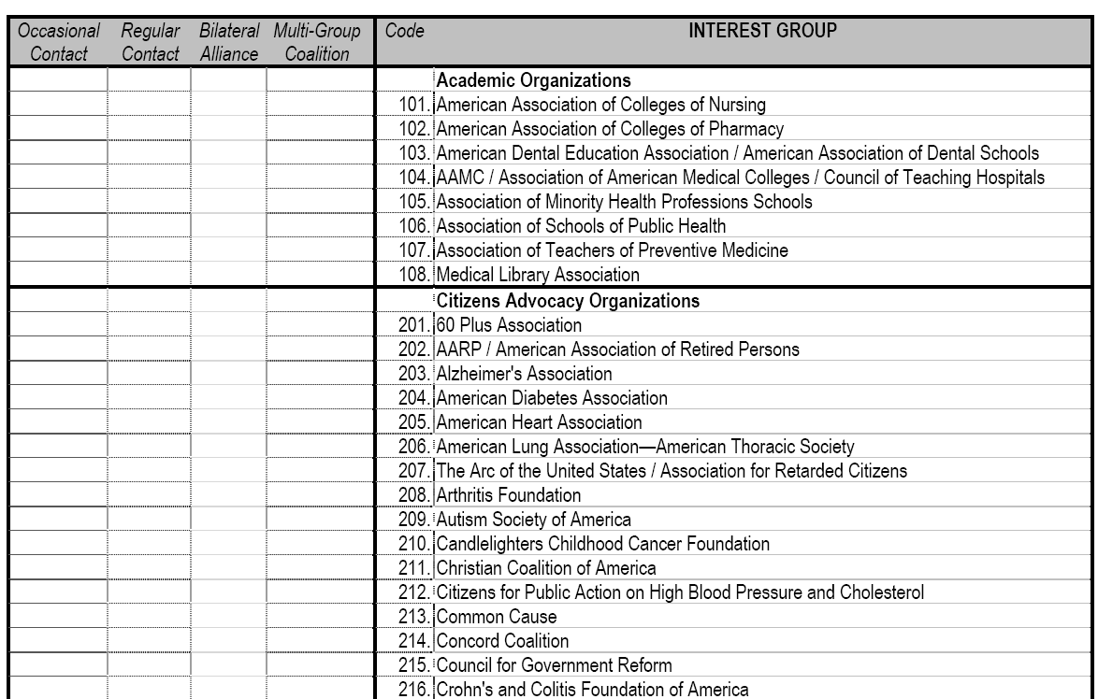
Fixed List

Slide 19
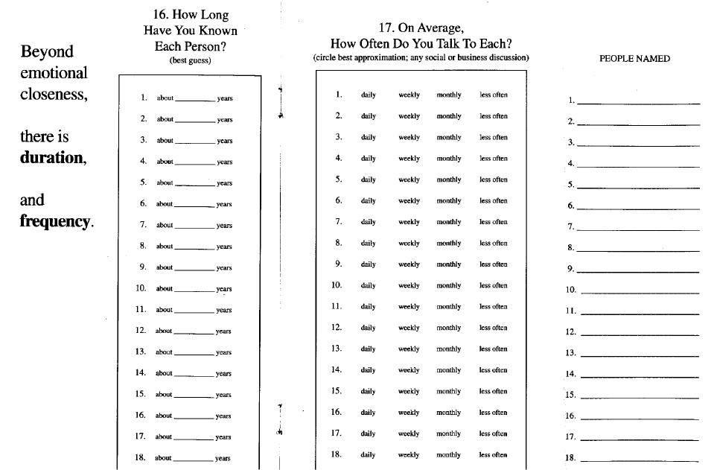
Name Generator
See
Merrill
Lynch
survey.

Slide 20
Fixed list: Advantages / Disadvantages
Advantages
-- People are less likely to “forget” social ties
-- Clearly defined network boundaries
-- Works well when the social system is small or when analyzing elites
-- Usually the approach when measuring whole network (but not always)

Slide 21
Fixed list: Advantages / Disadvantages
Disadvantages
-- Important network contacts may not be on the list
-- Difficult and time-consuming to go through entire list (fatigue effects)
-- Real network may be ill defined
-- Must have the “whole list” – works only in small networks – or elite networks

Slide 22
Name Generator: Advantages / Disadvantages
Advantages
-- Flexibility: people can name anyone they like
-- Efficiency: it is easy to ask for a large amount of information in a small space
-- Efficacy: Accommodates large social networks
-- Usually the approach when measuring ego networks (but not always)

Slide 23
Name Generator: Advantages / Disadvantages
Disadvantages
-- Forgetting is a major problem
-- Variance from person to person in threshold for listing
-- Measuring network degree may be highly unreliable

Slide 24
Tricks for Name Generators
Constrain the number of alters list (e.g., name your top three best friends) – highly problematic because it artificially constrains network degree
Multiple asking of the same (or similar) question
Allow respondents to revise their answers.
Prompt people with something concrete (e.g., who do you meet for coffee rather than who are your friends)

Slide 25
Types of Questions
Existence of Ties (e.g., Who are your friends?)
Frequency of ties (e.g., How often do you meet?)
Evaluation of ties (e.g., Who is your best friend? Who is most influential?)
Types of ties (e.g., What types of people are you tied to? Are your friends old, young, poli sci majors?)

Slide 26
Data Formats: Edgelist vs. Adjacency Matrix

Slide 27
Data Formats
Adjacency Matrix / Spreadsheet -- GOOD FOR SMALL NETWORKS
A B C D
A 1 0 1 0
B 0 1 0 1
C 1 0 1 0
D 0 1 0 1
Edgelist – GOOD FOR LARGE NETWORKS
AC
BD
EF
An adjacency matrix can be converted to an edgelist, and vice versa

Slide 28
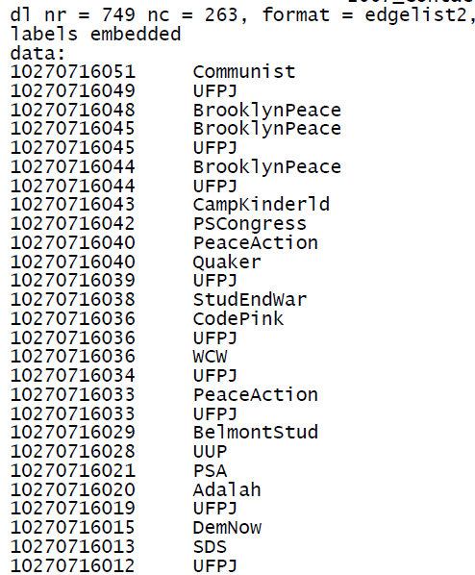
A Real Edgelist

Slide 29
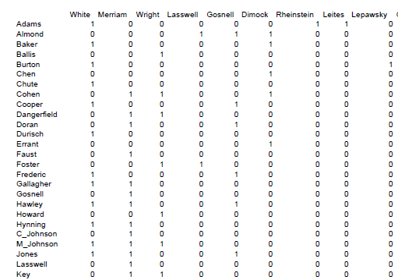
A Real Adjacency Matrix

Slide 30
Ethical Considerations
Some network data may not be easily anonymized
Is it legitimate to use network data for commercial purposes?

Slide 31
Questions / Comments ?

