Slide 1
Network Analysis Statistical Analysis of Social Network Data
Michael T. Heaney
University of GlasgoW
June 12, 2023
Lecture 02

Slide 2
Major Theories

Slide 3
Major Theories
Balance
Brokerage
Status Signals
Homophily
Multiplexity
Small Worlds
Preferential Attachment

Slide 4
The Need for Theory
Network analysis can be a cool toy.
It is easy to get lost in data crunching and forget about why we care about networks.
You must develop a theory of why and how networks matter in your case.
What are the mechanisms at work?
If larger degrees matter, why is that the case? If centrality helps, why is that the case? If centrality hurts, why is that the case?

Slide 5
Balance Theory
Fritz Heider, The Psychology of Interpersonal Relations (John Wiley and Sons, 1958).
The enemy of my enemy is my friend.
Multiply the valence of a legs of a triad by one another. Positive values imply balance, negative values imply imbalance.
Prediction: Imbalanced triads tend to adjust toward balance.
Entire networks can be assessed as balanced or imbalanced.
Potentially useful in the study of alliances, friendship.

Slide 6
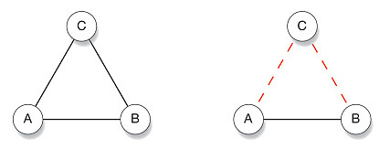
Balance Theory
Two balanced triangles
+1
-1
1 x 1 x 1 = 1
-1 x -1 x 1 =1

Slide 7
Balance Theory
Unbalanced triangles
C
C
A
B
A
B
1 x 1 x -1 = -1
-1 x -1 x -1 = -1

Slide 8
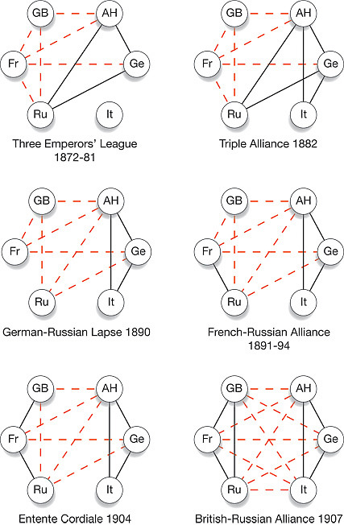
The Emergence of World War I (Steven Strogatz)

Slide 9
Brokerage
Brokers are actors who facilitate exchange among actors.
Brokerage may be necessary because actors who want to connect don’t know each other.
Or, actors may know each other, but may require brokerage because they don’t trust each other.

Slide 10
Brokerage Example – Strength of Weak Ties
Mark Granovetter, “The Strength of Weak Ties,” American Journal of Sociology (1973)
Also a kind of embeddedness theory.
What kind of information is communicated in a relationship depends on the strength of the tie.
Prediction: Weak ties are better at communicating new information because they are less likely to be redundant.
Prediction: Strong ties are better at communicating sensitive information.

Slide 11
Key to Brokerage
Brokerage is about crossing a boundary that is hard to cross
What kinds of boundaries are hard to cross?

Slide 12
Key to Brokerage
Brokerage is about crossing a boundary that is hard to cross
What kinds of boundaries are hard to cross?
Partisan boundaries
Industry boundaries
Gender boundaries
Other boundaries?

Slide 13
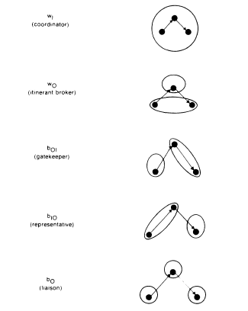
Types of Brokers
Roger V. Gould and Roberto M. Fernandez, “Structures of Mediation: A Formal Approach to Brokerage in Transaction Networks," Sociological Methodology (1989)

Slide 14
Brokerage Across Structural Holes
Ronald S. Burt, Structural Holes: The Social Structure of Competition (Harvard, 1992).
Structural hole theory is a specific type of brokerage theory.
It specifies that the type of boundary that it is valuable for brokers to cross.
Prediction: Brokers will add greater value when they build personal networks that are not redundant and are free of constraint. It is a way of becoming the unique contact across structural holes.

Slide 15
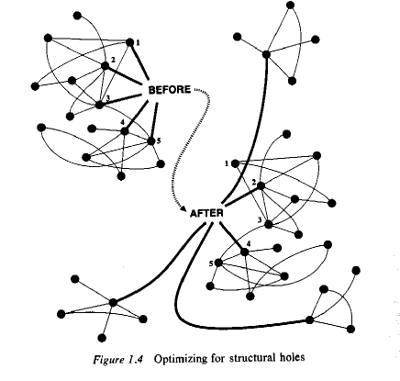

Slide 16
Status Signals
Joel M. Podolny, “Networks as the pipes and prisms of the market,” American Journal of Sociology (2001).
Networks do more than channel information and resources (cf. resource dependency theory), they also inform us about status.
Who we are connected to tells us something about our quality.
Prediction: It may be difficult to raise our status, given our network contacts.

Slide 17
Homophily

Slide 18
Homophily
Miller McPherson et al., “Birds of a Feather: Homophily in Social Networks,” Annual Review of Sociology (2001).
Prediction: Similarity in individual characteristics causes the formation of network ties.
Example: People form friends with people who share the same hobbies.
Implication: Creates difficulties in assessing the causal effect of social networks, since people may develop similar interests because they are friends or may become friends because they have similar interests. Obviously, it is both, but it is difficult to parse the difference empirically.

Slide 19
Measures of Homophily
Percent homophilous
E-I Index: Given a partition of a network into a number of mutually exclusive groups then the E-I index is the number of ties external to the groups minus the number of ties that are internal to the group divided by the total number of ties. This value can range from 1 to -1. Positive numbers imply heterophily, negative numbers imply homophily.
Need to account for the overall composition of the population. Is the population divided 90/10 or 50/50?
Lots other measures: e.g., Yules Q, Cohen Kappa

Slide 20
Multiplexity

Slide 21
Multiplexity
David Krackhardt, “The Strength of Strong Ties: The Importance of Philos in Organizations.” In Networks and Organization: Structure, Form, and Action (Harvard, 1992)
Action takes place in multiple, overlapping social networks. Family, business, friendship, political, sexual, etc.
Prediction: Ties in one kind of network affect ties in other kinds of networks.
Implication: Multiplexity may be an important explanation for coevolution.

Slide 22
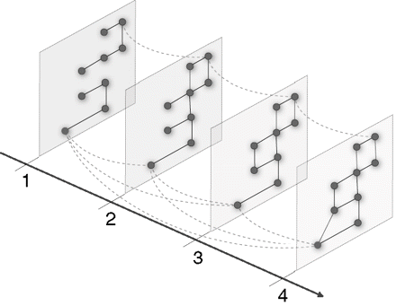
Visualizing Multiplexity

Slide 23
Multiplexity Example: Working and Dating
Would you like to work with someone that you dated? Why or why not?

Slide 24
Working and Dating
Working and dating are two very different types of social relationships. The relationships of co-worker and boyfriend/girlfriend have very different ROLES.
As a result, there are potentially unique advantages of combining these roles as well as potentially unique costs.

Slide 25
Working and Dating
Advantages
-- The two of you get to see one another more regularly.
-- You know that you have someone that you can trust and count on at work. You have an ally in the workplace.
Disadvantages
-- Dating and working together are very different roles.
-- Dating is about equality and seeking intrinsic goods (e.g., love, security, enjoyment)
-- Working together is often/usually about hierarchy and seeking extrinsic goods (e.g., career advancement, salary, producing a good)
-- These roles can direction come into conflict

Slide 26
Small World Theory

Slide 27
Small Worlds
Duncan Watts, Small Worlds (Princeton, 1999).
Is a theory about the macro structure of a network based on its micro structure.
All points in a network are “reachable” in a short number of steps.
Reachability exists because a small number of actors form bridges that span great distances.
Hubs – actors with especially high degree – are especially important in creating bridges – in part through processes of preferential attachment.

Slide 28
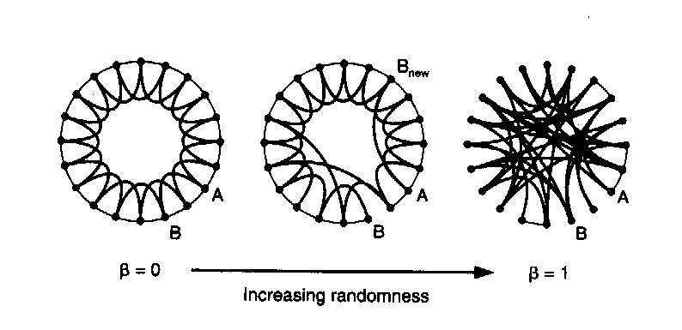
Watts’ Concept of the Small World
Caveman World
Small World
Neighborhood / Clique

Slide 29
Small Worlds Generally Follow Power Laws
The 80/20 rule
Exist when statistical distributions are “scale free”
That means that “relationships do not change if length scales are multiplied by a common factor (k).”
f(x) = ax^{k}
log (f(x)) = k log (x) + log (a)

Slide 30
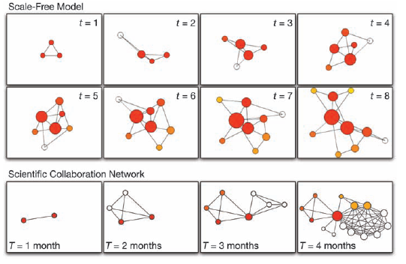
Preferential Attachment
Alberto-Laszlo Barabasi, Linked (Penguin, 2003)

Slide 31
Building Your Own Theory

Slide 32
Questions / Comments ?

Slide 33
New Directions for the Study of Networks

Slide 34
The Edges of the Field
Multi-modal analysis
Valued data
Missing data
Multiplexity
Multi-Level Models
Time-series models
Evolutionary models
Game-theoretic models

Slide 35
Challenges for the Study of Networks

Slide 36
Challenges for the Study of Networks
High-quality data
Data collection over time
Statistical innovation
Computing power

Slide 37
Questions / Comments ?

