Slide 1
Network Analysis Statistical Analysis of Social Network Data
Michael T. Heaney
University of GlasgoW
June 12, 2023
Lecture 01

Slide 2
Plan for the Course

Slide 3
Daily Schedule
9am-12pm: Morning Session
1pm-3pm: Afternoon Session
Thursday: Class extends to 5:30pm (required)
To earn credit, you must attend 80% of all sessions.

Slide 4
Day by Day
Monday: Lectures all day (ask LOTS of questions); Start looking for data.
Tuesday: Mostly computer exercises; some lecture; finalize your data selection.
Wednesday: Lecture; exercises; individual consultations; Get your data working in R.
Thursday: Lecture; exercises; finalize your R results (class ends at 5:30pm).
Friday: Individual presentations in morning; Extended applications in the afternoon; celebration.

Slide 5
Data Specifications for Your Project
Data must include:
Network ties
Either nodal attributes or edge attributes (or both)
Suggested size:
25 to 200 nodes
If your data is much larger than 200 nodes, it may be wish to take a subsample of your data for illustrative purposes.
We will discuss the meaning of the above terminology today.

Slide 6
Advice on Data Selection
If you are already using network data, then you may be able to use it for your project.
If not, try to find an existing dataset in your general area of interest.
Most journal articles these days make data available along with publication. Consult journals such as Social Networks and Network Science.
Harvard Dataverse may be a good source of data: https://dataverse.harvard.edu/

Slide 7
Friday Presentations
You MUST give a presentation on Friday in order to receive credit for the course.
It is a lot to do in one week, but you CAN do it.
Presentations should be 15 minutes plus 5 minutes for questions.
Model your presentation after a conference presentation.

Slide 8
Guidance for Presentations
Start by talking about the substantive, theoretical, or methodological problems that motivate your work.
What expectations / hypotheses that you wish to evaluate?
What is the nature of your data?
Summarize your data.
Conduct appropriate ERGM analyses.
Evaluate the convergence and fit of your ERGMs.
What are your conclusions?
What would you do if you had one year more to work on it?

Slide 9
Problem Sets
There is a problem set to complete along with every computer exercise.
All problem sets should be submitted by email by June 30 if you wish to receive credit for the course.

Slide 10
Readings
Listed the syllabus.
Are not expected for this week but are strongly recommended if you plan to do further work using social network analysis.

Slide 11
Introduction

Slide 12
Introduction
Definition
Motivation
Data Gathering
Relational Thinking

Slide 13
What Are Networks?
Networks are patterns of relationships that connect individuals, institutions, or objects (or leave them disconnected).

Slide 14
What Are Networks?
Networks are patterns of relationships that connect individuals, institutions, or objects (or leave them disconnected).
EXAMPLES
The lineage of a family
Giving and receiving grooming among gorillas
Patterns of contracts among firms
Individuals’ co-memberships in organizations
A computer system that allows people to form friendships or meet potential mates
Citations between academic papers

Slide 15
Why Study Networks?
Networks are substantive phenomena we care about (e.g., Facebook, a health care network, a policy network)
We may theorize that access to networks affects an outcome we care about (e.g., Does access to social support through family networks affect mothers’ success in raising their infants?)
Network analysis may provide a methodological approach that solves a research problem (e.g., Which worker at an office has access to the most timely information?)

Slide 16
When to Study Networks?
All human activity is embedded within networks, so anything could be studied using network analysis.

Slide 17
When to Study Networks?
All human activity is embedded within networks, so anything could be studied using network analysis.
But just because network analysis is possible does not mean that it is desirable.

Slide 18
When to Study Networks?
All human activity is embedded within networks, so anything could be studied using network analysis.
But just because network analysis is possible does not mean that it is desirable.
The question we want to ask is: When in the network aspect of phenomenon particularly pertinent to the social dynamics that matter to us?

Slide 19
Some Good Opportunities for Network Analysis
When then the informal organization of a system competes with or replaces formal organization

Slide 20
Some Good Opportunities for Network Analysis
When then the informal organization of a system competes with or replaces formal organization
When formal organization has multiple levels or complex formal inter-relationships (e.g., departmental interaction in an international firm)

Slide 21
Some Good Opportunities for Network Analysis
When then the informal organization of a system competes with or replaces formal organization
When formal organization has multiple levels or complex formal inter-relationships (e.g., departmental interaction in an international firm)
When access to information is especially important to the outcomes in question (e.g., understanding why consumers switch their purchasing behavior after exposure to social media)

Slide 22
Some Good Opportunities for Network Analysis
When then the informal organization of a system competes with or replaces formal organization
When formal organization has multiple levels or complex formal inter-relationships (e.g., departmental interaction in an international firm)
When access to information is especially important to the outcomes in question (e.g., understanding why consumers switch their purchasing behavior after exposure to social media)
Coordination, cooperation, or trust is a key part of a process (e.g., understanding the composition of cross-party coalitions among legislators)

Slide 23
Data-gathering Approaches
Multiple data-gathering approaches are valid:
Ethnography
Interviews
Surveys
Experiments
Web scraping
Archival analysis

Slide 24
Example: Ethnography
Mario Luis Small, Unanticipated Gains: Origins of Network Inequality in Everyday Life (Oxford 2009)
Observation of and interviews with mothers whose children were enrolled in New York City childcare centers. Qualitative analysis.
Argues that “how much people gain from their networks depends fundamentally on the organizations in which those networks are embedded.” (iv)
Networks matter not only because of size, but because of “the nature, quality, and usefulness of people’s networks.”
Demonstrates the development of social capital.

Slide 25
Example: Interviews
Mildred A. Schwartz, The Party Network: The Robust Organization of Illinois Republicans (Wisconsin, 1990).
Interviews with 200 informants within the Illinois Republican Party. One-hour interviews repeated up to three times with each informant.
Argues that although hierarchy is a part of a party structure, they do not function as a single hierarchy or oligarchy. They are decentralized and loosely coupled.
Networks are critical to party adaptation over time.

Slide 26
Example: Surveys
Mark Granovetter, Getting a Job: A Study of Contacts and Careers (Chicago, 1974)
A random sample of residents of Newton, Massachusetts. Asked for information about how they learned about job opportunities.
Found that new information about job opportunities was more likely to be obtained by people with who respondents had “weak ties” rather than “strong ties.”
“Weak ties” are more useful for communicating new information, while “strong ties” tend to communicate redundant information.

Slide 27
Example: Experiments
David W. Nickerson, “Is voting contagious? Evidence from two field experiments,” American Political Science Review (February 2008).
A field experiment within two different get-out-the-vote campaigns. Examined how the voting behavior of other persons in a household is affected by communication with one person in the household.
Found that 60% of the increased propensity to vote (from the get-out-the-vote campaign) is passed onto the other member of the household.

Slide 28
Example: Web Scraping
Lada Adamic and Natalie Glance, “The Political Blogosphere and the 2004 U.S. Election: Divided They Blog”, Proceedings of the 3rd international workshop on Link discovery, March 2005
Examines linking patterns and discussion among bloggers
Finds polarized networks with more interlinkage in conservative blogs than liberal blogs

Slide 29
Example: Archival Analysis
John W. Mohr, “Soldiers, Mothers, Tramps and Others: Discourse Roles in the 1907 New York City Charity Directory,” Poetics (June 1994).
Examined types of eligible clients in the 1907 New York City Charity Directory. Examined how identities emerged based on similarities of which social categories were grouped together.
Treatment depended on whether status was achieved (e.g., soldiers) or ascribed (e.g., mothers). Distinctions were commonly made based on deservingness and gender.

Slide 30
Methods of Analysis Vary
Qualitative
Graphical
Quantitative – Descriptive
Quantitative – Analytical

Slide 31
Methods of Analysis Vary
Qualitative
Observe how some actors use their networks differently than others.
Graphical
Graph a network structure and talk about its implications.
Quantitative – Descriptive
Describe the size of networks and what types of actors are contained in them.
Quantitative – Analytical
Include measures of network structure as independent variables in regression analysis.
Make the existence of a network tie the dependent variable in a regression.
Test whether theoretical construction of a network is consistent with its empirical realization (e.g., should a network be centralized, decentralized?)

Slide 32
Relational Thinking
Much of social science emphasizes the individual as a unit of analysis.
Why do some businesses work more collaboratively than others?
Network analysis tends to place a strong emphasis on the relationship (or “the dyad”) as a unit of analysis.
Why do firms A and B form a joint partnernship?
It is sometimes difficult to get our minds around a relational approach to theorizing.
Individual thinking: “It’s not you, its me.”
Relational thinking: “Its neither you nor me, it’s us.”
Mustafa Emirbayer, “Manifesto for a Relational Sociology” American
Journal of Sociology (September 1997).

Slide 33
Questions / Comments ?

Slide 34
Key Concepts

Slide 35
Key Concepts
Graphs
Matrices
Modes

Slide 36
Graphs

Slide 37
Graphs
Social networks can be represented as graphs.
Graphs are made up of nodes (i.e., actors) that are connected by links (i.e., relationships).
LINK
NODE

Slide 38
Nodes and Links
Node = Point, Vertex, Actor, Individual
Examples: Person, Firm, Nation-State, City, Organization, Word, Article
Link = Line, Edge, Tie, Connection, Relationship
Examples: Joint Venture, Communication, Animosity, Citation, Marriage, Sex, Fighting a War, Co-membership

Slide 39
Types of Links
Undirected vs. directed links
Dichotomous vs. Valued Links

Slide 40
Undirected Links
Undirected links, denoted with a simple straight line, are used whenever it is impossible that there is asymmetry in a relationship. The relationship is inherently symmetric.
If A is married to B, then B must be married to A. It is not possible for A to be married to B without B being married to A.
A
B

Slide 41
Directed Links
Directed links, denoted with arrowheads, are used whenever it is possible that there is asymmetry in a relationship:
A gives money to B, but B gives nothing to A.
B gives money to A, but A gives nothing to B.
A and B give money to each other.
A and B give nothing to each other.
A
B
A
B
A
B
A
B

Slide 42
Dichotomous vs. Valued Links
Dichotomous – either a link exists or it doesn’t (e.g., either we are friends or we’re not, either two nations are at war or they’re not, either we are married or we are not). Represent with the presence of a line:
Valued – links vary in their strength (e.g., our friendship may be strong or weak; we may have one friend in common or 3). Represent with varied line formats:

Slide 43
Complete Graphs and Connectivity
Complete Graph – all possible ties exist:
Not a Complete Graph, but a Connected Graph
Not a Connected Graph

Slide 44
Components
MINOR COMPONENT
MAJOR COMPONENT

Slide 45
Components
Component – the set of all points that constitutes a connected subgraph within a network
Main component – the largest component within a network
Minor component – a component that is smaller than the main component – there may be many minor components

Slide 46
Key Parts of a Graph
MINOR COMPONENT
PENDANT
ISOLATE
MAJOR COMPONENT

Slide 47
Pendants and Isolates
Pendant – a node that only has one link to a network
Isolate – a node that has no links to a network

Slide 48
Matrices

Slide 49
Matrices
Networks may be represented as matrices
The most basic matrix is an adjacency matrix
A 1 indicates the presence of a link, while a 0 indicates the absence of a link.
 | Georg | Riham | Ayshea | Vikram
Georg | 1 | 0 | 1 | 0
Riham | 0 | 1 | 1 | 0
Ayshea | 1 | 1 | 1 | 0
Vikram | 0 | 0 | 0 | 1

Slide 50
Symmetric Matrices
If matrices are symmetric, they may be represented by upper or lower triangle only.
The diagonal may be omitted in this case because it is reflexive.
 | Georg | Riham | Ayshea | Vikram
Georg
Riham | 0
Ayshea | 1 | 1
Vikram | 0 | 0 | 0

Slide 51
Modes

Slide 52
Modes
A mode is a class of nodes in a network.
Network analysis typically involves only one mode.
For example, friendships among a group of students would usually be modeled using one mode.

Slide 53
Example: One-Mode Network
Friendship Network of workers at a high-tech company (Krackhardt 1992)

Slide 54
Two Modes
Sometimes we want to know how one class of nodes relates to another class of nodes.
Examples:
Mode 1 | Mode 2
Mentor | Mentee
People | Events
Firms | Trade Associations
Interest Groups | Coalitions
Legislators | Caucuses
Nation States | Treaties

Slide 55
One-Mode vs. Two-Mode Models
One-mode models are simpler and more parsimonious.
Two-mode data are more realistic but less parsimonious
We want to think about the trade offs of modeling our data using one mode versus two modes.

Slide 56
From Two Modes to One Mode
Ronald L. Breiger, "The Duality of Persons and Groups," Social Forces (1974).
If data have two modes, it is possible to reduce the dimensionality of the data using either mode.
Example: If two-mode data have people (Mode X) and organizations (Mode Y), it is possible to reduce them to either people only or organizations only.
Mode X: People linked by their co-membership in organizations.
Mode Y: Organizations linked by common members.

Slide 57
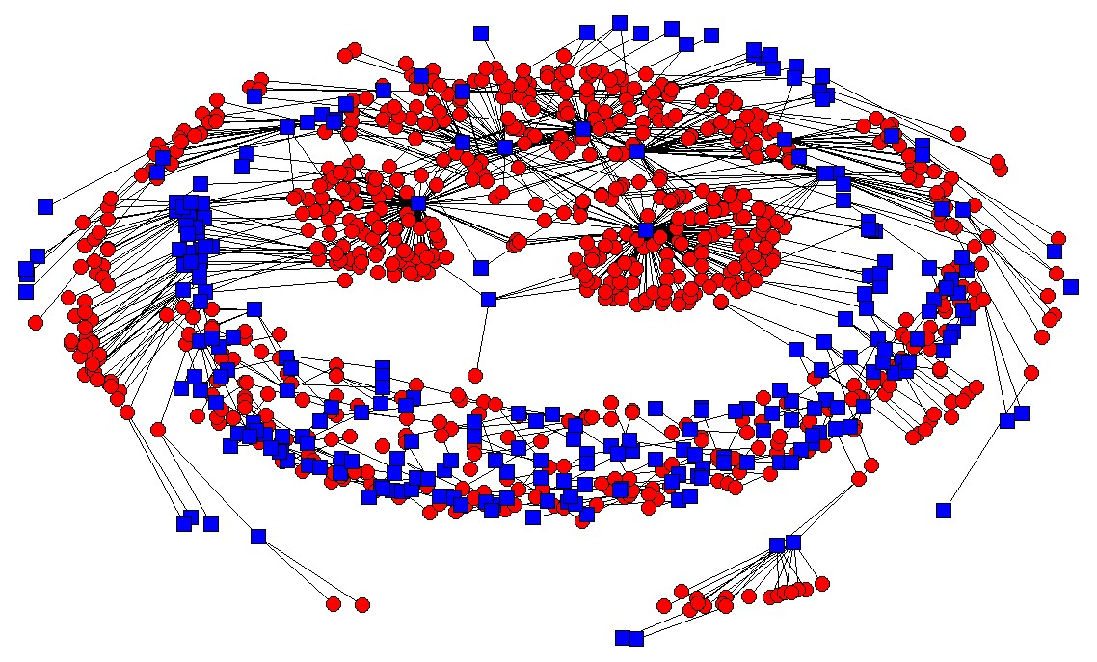
Example: People and Organizations in the USA Antiwar Movement
Two-mode network (Circles=People; Squares=Orgs)

Slide 58
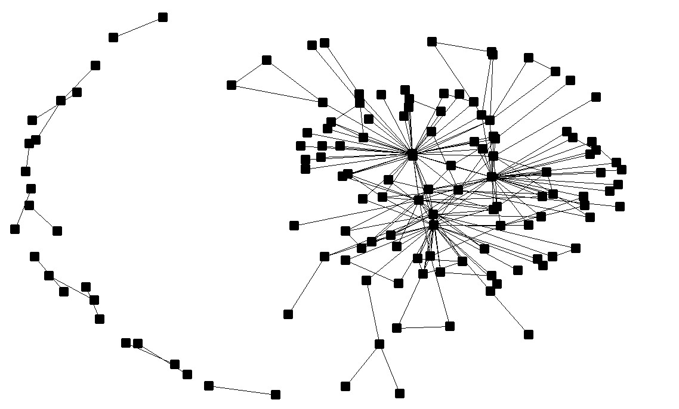
Organizations Linked by Common Members
One-Mode Network

Slide 59
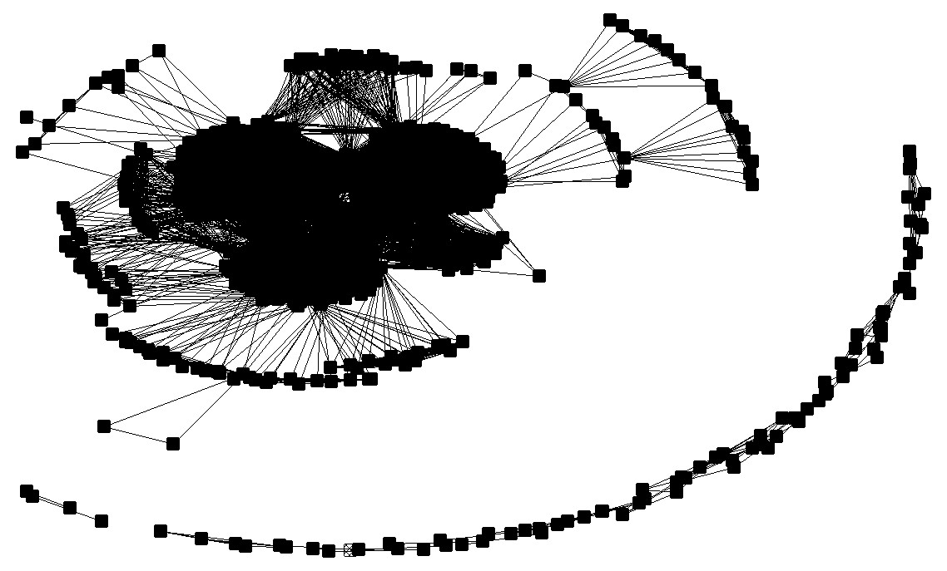
People linked by Organizational Co-membership
One-mode network

Slide 60
Discussion: Which Graph is Most Revealing?

Slide 61
A Polished Example

Slide 62
Advantages vs. Disadvantages
Advantages of Going from 2-mode to 1-mode
Reduce the dimension of the data
Make it easier to visualize
Focus on what really matters
Disadvantages of going from 2-mode to 1-mode
Lose information
Confuse the reader
Eliminate the important relationships
Depends entirely on your case

Slide 63
Converting Data From Two Modes to One Mode
Try it by hand – it’s easy!
 | Calculus | Physics | Politics | Spanish
Georg | 1 | 1 | 0 | 0
Riham | 0 | 0 | 1 | 1
Ayshea | 0 | 1 | 1 | 0
Vikram | 1 | 1 | 0 | 1
This two-mode
network:
Can be reduced to this one-mode matrix:
Or this one:
 | Georg | Riham | Ayshea | Vikram
Georg
Riham
Ayshea
Vikram
 | Calculus | Physics | Politics | Spanish
Calculus
Physics
Politics
Spanish

Slide 64
Converting Data From Two Modes to One Mode
 | Calculus | Physics | Politics | Spanish
Georg | 1 | 1 | 0 | 0
Riham | 0 | 0 | 1 | 1
Ayshea | 0 | 1 | 1 | 0
Vikram | 1 | 1 | 0 | 1
This two-mode
network:
Can be reduced to this one-mode
matrix:
 | Georg | Riham | Ayshea | Vikram
Georg | 2
Riham | 0 | 2
Ayshea | 1 | 1 | 2
Vikram | 2 | 1 | 1 | 3
 | Calculus | Physics | Politics | Spanish
Calculus | 2
Physics | 2 | 3
Politics | 0 | 1 | 2
Spanish | 1 | 1 | 1 | 2
Or this one:
These are affiliation networks – the valued ties can be represented as thickness. The diagonal is meaningful in this case.

Slide 65
Converting Data From Two Modes to One Mode
When we are working with matrices, this transformation is even easier.
One-Mode Projection by Rows = Two-Mode Network %*% (Two-Mode Network)^{T}
One-Mode Projection by Columns = (Two-Mode Network)^{T} %*% Two-Mode Network
Note that:
T = Transpose
%*% = Matrix Multiplication

Slide 66
More than Two Modes
It is possible for network data to have more than two modes.
Example
Mode 1: Firms
Mode 2: Trade Associations
Mode 3: Nations

Slide 67
Lattices are often used to depict and analyze higher-order modal models
Ann Mische, Partisan Publics: Communication and Contention across Brazilian Youth Activist Networks (Princeton, 2008).

Slide 68
Another Lattice from Ann Mische

Slide 69
The Limits of Multi-Modal Analysis
Almost all network analysis can be conducted using when one-mode data is on hand.
In many network software programs two-mode measures (e.g., centrality) can be easily generated. But progress in this area is still moving forward.
Some work has been done on higher-order modes, but work needs to be done to make their analysis practical for social scientists.

Slide 70
Questions / Discussion about Modes?

Slide 71
Development of Social Network Analysis

Slide 72
Origins of Network Analysis
Early social theorists: Durkheim, Marx, and Weber, for example, were interested in the relation between the individual and society
Georg Simmel: web of group affiliations; the triad
Jacob Moreno: First efforts to map social structures

Slide 73
Multidisciplinary Advances, 1940-1970
Mathematics / graph theory
Political Science
Sociology
Anthropology

Slide 74
Sociological Consolidation, 1970-1995
The Harvard School -- Harrison White and colleagues
Sociometric advances
John Padgett, multiple networks and robust action

Slide 75
Network Explosion, 1995-2010
Physics and networks (Duncan Watts)
Economics and game theory (Mathew Jackson)
Public Health (Christakis and Fowler)
Adoption in many fields

Slide 76
Institutionalization, 2010-present
Growth of network associations
The concept of “network science”
Wider availability of software

Slide 77
Discussion
How could network science fit into your discipline and research fields?
What are some promising areas for growth?

Slide 78
Good Introductory Readings
Albert-Laslo Barabasi, Linked (Penguin 2003).
Stephen P. Borgatti et al., Analyzing Social Networks (Sage 2013)
Lincton C. Freeman, “Centrality in Social Networks: I. Conceptual Clarification,” Social Networks (1979).
Linton C. Freeman, The Development of Social Network Analysis (Empirical Press 2004).
Matthew O. Jackson, Social and Economic Networks (Princeton 2008).
Eric E. Kolaczyk and Gabor Csardi, Statistical Analysis of Network Data with R (Springer 2014).
John Levi Martin, Social Structures (Princeton 2009)
Mark Newman, Networks: An Introduction (Oxford 2010).
Mark Newman et al., The Structure and Dynamics of Networks (Princeton 2006).
Garry Robins, Doing Network Research (Sage 2015)
John Scott, Social Network Analysis: An Handbook (Sage, 2000.
Stanley Wasserman and Katherine Faust, Social Network Analysis: Methods and Applications (Cambridge 1994).
Issues of the journals, Social Networks, Network Science, and the Journal of Social Structure

